Slide 1
Employee Data Analysis using Excel
STUDENT NAME : SANKARI B
REGISTER NO : 312206338 (unm299a&f42)
DEPARTMENT : B.COM(ACCOUNTING & FINANCE)
COLLEGE : S.S.K.V. ARTS AND SCIENCE COLLEGE FOR WOMEN

Slide 2
PROJECT TITLE
Employee Performance Analysis using Excel

Slide 3


AGENDA
Problem Statement
Project Overview
End Users
Our Solution and Proposition
Dataset Description
Modelling Approach
Results and Discussion
Conclusion
3/21/2024 Annual Review

Slide 4

PROBLEM STATEMENT
The problem statement aims to highlight the pressing issue the research intends to address.

Slide 5

PROJECT OVERVIEW
Employment Data typically includes labor force statistics and employee information such as name, employer, position, address, number of hours, salary or payroll information, employment rates, and status.

Slide 6

WHO ARE THE END USERS?
Multiple people and departments within an organization use employee data, including:
Accounting
Human resources (HR)
Recruiters
Investors

Slide 7

OUR SOLUTION AND ITS VALUE PROPOSITION CONDITIONAL FORMATTING - MSSING FILTER - REMOVE FORMULA -PERFORMANCE PIVOT -SUMMARY GRAPH -DATA VISUALIZTION

Slide 8
Dataset Description
EMPLOYEE -KAGGLE
EMPLOYEE ID -NUM
EMPLOYEE NAME(FIRST,LAST) -TEXT
EMPLOYEE TYPE -TEXT
PERFORMNCELEVELGENDER- TEXT
EMPLOYEE RATING -TEXT

Slide 9

THE "WOW" IN OUR SOLUTION
=IFS(Z2>=5,"VERYHIGH",Z2>=4,"HIGH",Z2>=3,"MEDIUM",TRUE,"LOW")
3/21/2024 Annual Review
9

Slide 10
MODELING
DATA COLLECTION
Surveys
Interviews
Observations
focus groups
2.FEATURE COLLECTION
Focus groups
Prompt data collection
Survey methodology
High quality data collection devices

Slide 11
MODELING
3.DATA CLEANING
fixing or removing incorrect
corrupted
incorrectly formatted
duplicate or incomplete data within a dataset
4. PERFORMANCE LEVEL
Effectiveness
Efficiency
Productivity
Quality

Slide 12
MODELLING
5.SUMMARY
Personal details
Work history
6.VISULAZATION
Data visualization is the process of using visual elements like charts, graphs, or maps to represent data. It translates complex, high-volume, or numerical data into a visual representation that is easier to process
12

Slide 13
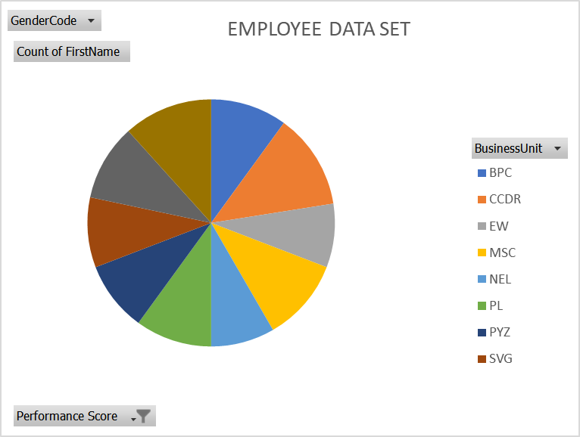
RESULTS
13

Slide 14
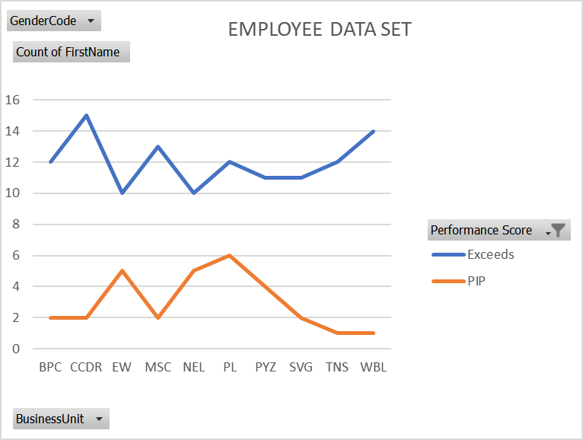
RESULT

Slide 15
CONCLUSION
He data set contains employee numbers and names, gender, city, job title, department, store location, business unit, division, age, length of service, and the number of hour absent.

Slide 16
THANK YOU!!!!......

